Slide 1
Using Markdown & Free Tools to Write, Publish, & Share an Open-Source Scientific Writing Guide
Dan Johnson
Wake Forest University
Notes:
1920 x 1080

Slide 2
Goals & Outline for Today
QUICK tour of SEM, goals for our Resource Guide
Download Guide from GitHub
Identify missing resources to add
Create multi-platform documents in Markdown
Use R Studio, free tools to convert Markdown to other formats
Turn simple Markdown documents into complex books and manuals
Build lists of suggested additions to the Guide, your questions; tips for Zoomifying workshops

Slide 3
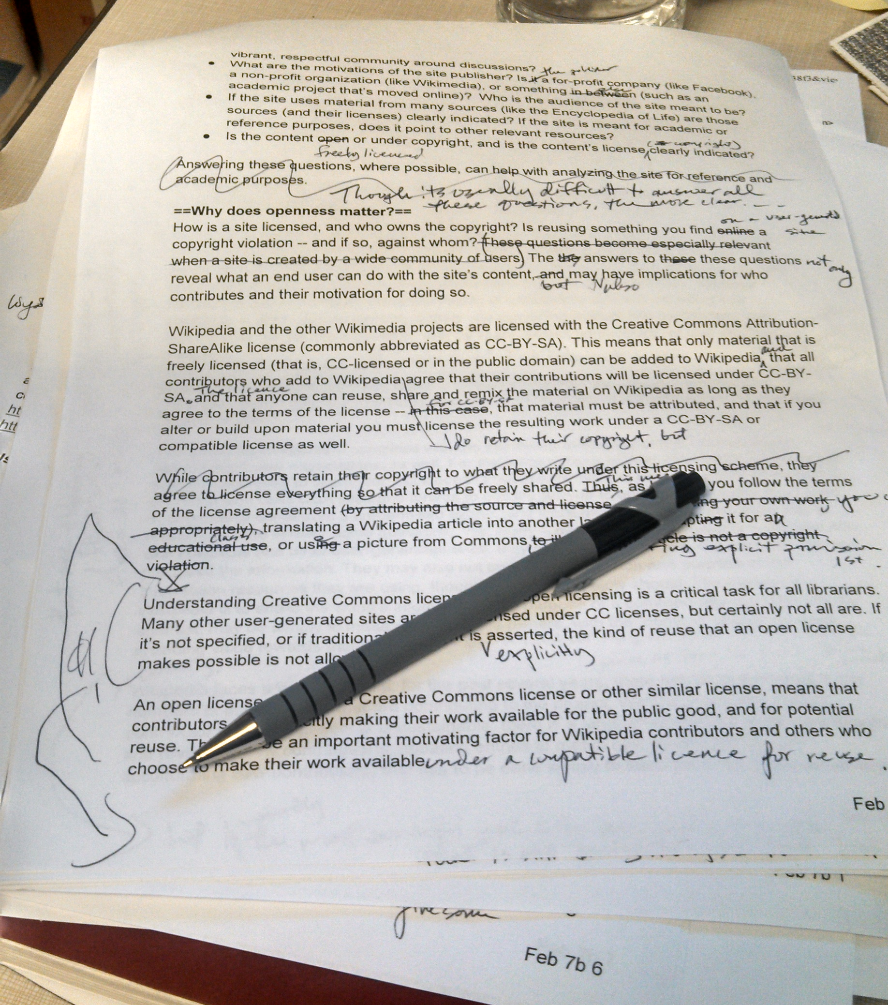
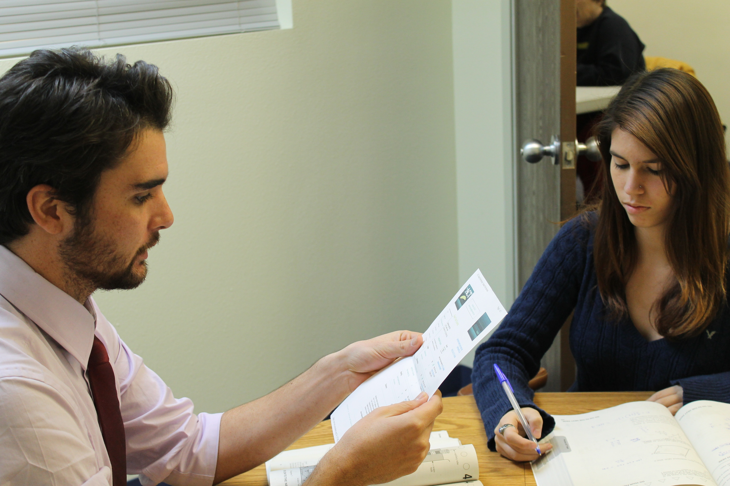
Tell the Truth…Is THIS Your Reality?

Slide 4
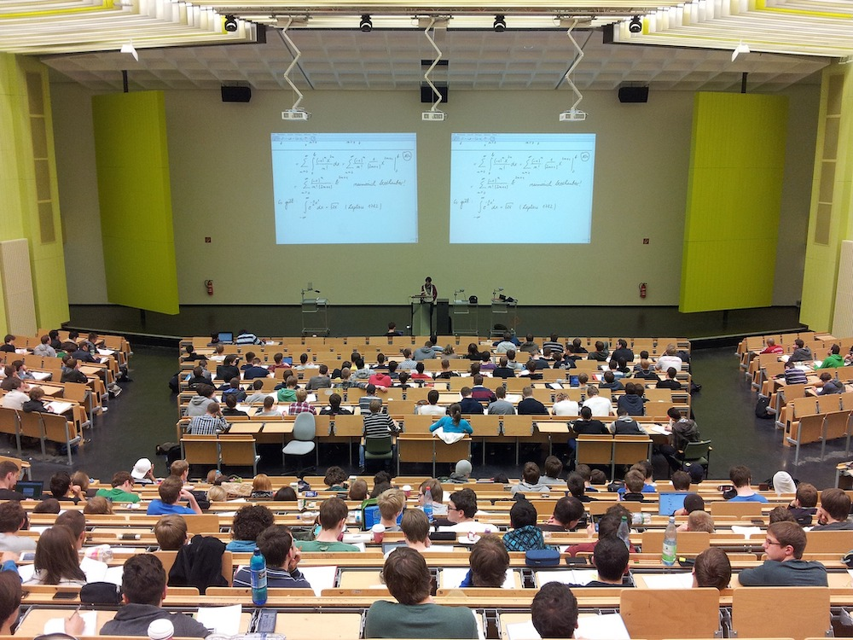
…Or Is THIS Closer to Your Reality?

Slide 5
How STEM Teaches Writing is NOT How Pros Do It
Program Design Differences |  |  | Instructor Differences
STEM Programs | Writing Programs |  | STEM Programs | Writing Programs
100s of students/ sem. | 15/sec., 60/sem. |  | Extensive copy-editing | Less editing, more coaching to self-correct
GTAs; add-on goal | Professionals; 1 goal |  | Overload students with corrections | Limit feedback, priority is biggest errors first
Ad hoc approach | Evidence-based best practices |  | Mechanics >> structure | Structure >> mechanics
Assume goals, purpose are clear | Assess students; do they see goals, purpose? |  | What else??

Slide 6
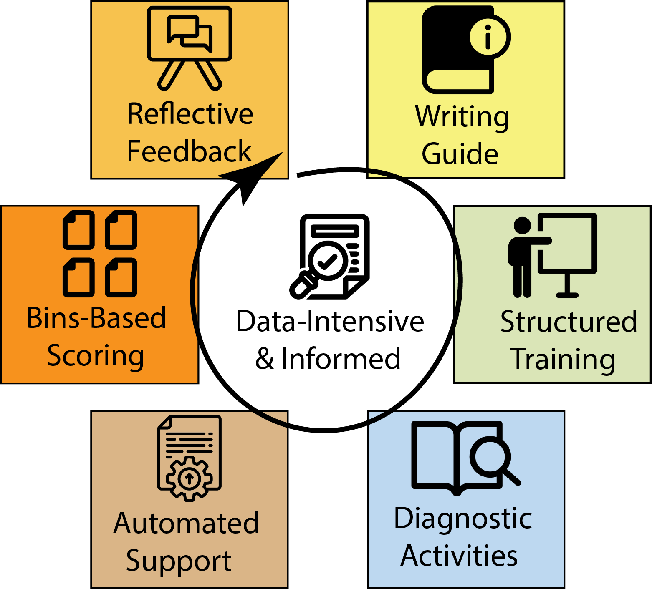
Our Approach: Six Elements Model (SEM)
Adapt WAC/WID practices to STEM’s reality
Improve on what works
Remove what doesn’t
Leverage data science, computational methods
Make student experience more “authentic”
Give instructors time back
https://stemwritingproject.org/

Slide 7
Our Approach: Writing Guide (today)
“Why” not just “what” we do when writing
Stable requirements
Refer students rather than copy-edit
Avoid field-specific idioms
https://adanieljohnson.github.io/ABLE_2022_Workshop/

Slide 8
Our Approach: Instructor AND Student Training
Students
Read, annotate before writing
Low-stakes practice
Peer review
Instructors
Pre-grading practice
Round-robin grading
Post-grading checks

Slide 9
Our Approach: Diagnostic Data
Embedded in activities
Occur BEFORE students write
ID specific knowledge, skills gaps
Teaches GTAs to:
Modify instruction to match needs
Use data in teaching practice

Slide 10
Our Approach: Automated Support
Spend less time on “low-gain” activities:
Is report complete?
Mechanical elements present?
Collect data over time about writing by a cohort
https://github.com/adanieljohnson/SAWHET_2

Slide 11
Our Approach: Bins-Based Scoring
Scores based on ~20 binary features:
Meets all basic criteria?
Are there flaws in writing, logic, or technical requirements?
Faster, fairer grading:
Time for submission/revision
Points arguments change to deeper discussions

Slide 12
Our Approach: Reflective Feedback, Coaching
Student is in charge of improving, correcting
Helps students learn to ask right questions about their OWN work
Limited/no copy editing
Refer authors back to Writing Guide, training activities
Look to 1º lit. for examples
BIOME 2022 Workshop: 7/21, 1pm EST (tent.)

Slide 13
Outline for Today
QUICK tour of SEM, purpose of our Resource Guide
Download Guide from GitHub
Identify missing resources to add
Create reusable documents in Markdown
Use R Studio, free tools to convert Markdown to other formats
Turn simple Markdown documents into complex books and manuals
Build a list of suggested additions to the Guide, & your questions

Slide 14
In Teams: Download Writing Guide Files
Goals:
Download full copy of Resource Guide
Look at Table of Contents:
Compile a list of MISSING items
Keep adding to this list during the workshop
Compare .md text files to rendered versions (.html, .docx)
How does markup translate to final format?

Slide 15
Outline for Today
QUICK tour of SEM, purpose of our Resource Guide
Download Guide from GitHub
Identify missing resources to add
Create reusable documents in Markdown
Use R Studio, free tools to convert Markdown to other formats
Turn simple Markdown documents into complex books and manuals
Build a list of suggested additions to the Guide, & your questions

Slide 16
All Texts Have Four Key Pieces – Content, Structure, Expected Outputs, Time Invested
To make texts reusable you need to think of these as separate elements.
Maximally reusable writing must have these elements in a certain place and in a certain format
Your time = limited resource
Following a FEW rules & constraints saves HOURS of time

Slide 17
In Teams: Edit, Then Create NEW .md Files
Your goals:
Use a plain text editor to:
Edit an existing .md file
Create a new .md file
Use R Studio to:
Edit an existing .md file
Create a new .md file
As you work, ask:
Which parts of a document are:
Content
Structure
What determines what the output looks like?
Where do you spend time?

Slide 18
Outline for Today
QUICK tour of SEM, purpose of our Resource Guide
Download Guide from GitHub
Identify missing resources to add
Create reusable documents in Markdown
Use R Studio, free tools to convert Markdown to other formats
Turn simple Markdown documents into complex books and manuals
Build a list of suggested additions to the Guide, & your questions

Slide 19
In Teams: Convert Your Markdown Files
Try:
Your text editor (.html)
Ashkanph converter (.html)
R Studio (.docx)
Demo 1:
Pandoc via terminal (.docx, .html)

Slide 20
Outline for Today
QUICK tour of SEM, purpose of our Resource Guide
Download Guide from GitHub
Identify missing resources to add
Create reusable documents in Markdown
Use R Studio, free tools to convert Markdown to other formats
Turn Markdown documents into complex books and manuals
Build a list of suggested additions to the Guide, & your questions

Slide 21
Demo 2: Building Books with R Studio
Workflow:
Start with a template from GitHub
Write text in plain .md, then add coding, .rmd
Build in stages, check regularly
Back up materials OFTEN
Keep book, non-book work separated

Slide 22
Demo 3: GitHub for Project Management
Why use GitHub vs.:
Google
Slack
Hosted server space
What can GitHub do?
Backups
Sync workspaces
Host projects
BASIL
Awesome Biology
OpenCB

Slide 23
Outline for Today
QUICK tour of SEM, purpose of our Resource Guide
Download Guide from GitHub
Identify missing resources to add
Create reusable documents in Markdown
Use R Studio, free tools to convert Markdown to other formats
Turn simple Markdown documents into complex books and manuals
Build a list of suggested additions to Guide, & your questions

Slide 24
In Teams: Debrief
Writing Guide
Training Strategy
What pages:
Are missing, needed?
Need revision, updating?
What other tools should be added?
Common novice questions, mistakes
What worked - KEEP?
What did not work - CHANGE or DROP?
What to ADD?

Slide 25
In Teams: Improving Zoom For Workshops
What I tried today:
Clear agenda, pre-wkshp instructions
Lab space vs. office
Full body camera
List of paste-ready links for chat
Use chat as a stream-of- consciousness capture
Teams-based work, but NOT in breakout rooms
Add Zoom recording to workshop materials

Slide 26
In Teams: Improving Zoom For Workshops
Published suggestions - how might others use them?
Assign roles
Open whiteboard
Enable slide annotation
Use virtual backgrounds well
Add polls
“Bite-sized” content blocks
Stay conversational
Use strong visuals

Slide 27
THANKS for coming today!
Fill out evaluation!
Check out our project resources at:
stemwritingproject.org (links to BioQUEST Hub)
Notes:
1920 x 1080

